Slide 1
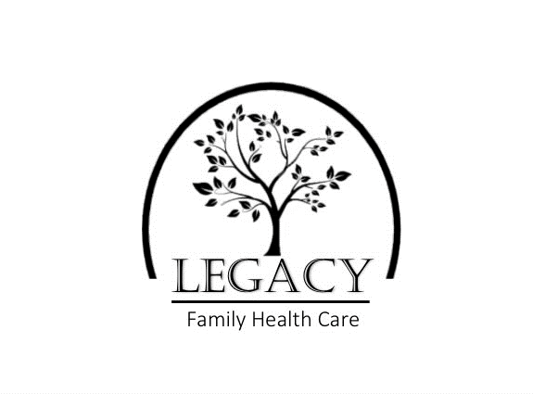

Slide 2
“Direct Primary Care is a cost-effective solution that will address 90% of your primary healthcare needs.”
– Paul Thomas, MD

Slide 3
What is Direct Primary Care?
DPC is a new way to receive high quality health care from a compassionate, dedicated Provider for a low monthly fee comparable to the cost of a cell phone.
Providers typically have a patient base of 2,500 – 5,000. DPC providers focus on ¼ the patient base allowing them to dedicate more time to each patient. Patients needs are at the heart of DPC.
No insurance plans, no corporate health systems, no middleman, just Providers and Patients working together for optimal health. With a low monthly membership fee patients of Legacy Family Healthcare receive unlimited office visits, same day or next day appointments, labs, medication supplies and after-hours access to your provider.

Slide 4
DPC in the words of Legacy’s Founder:
“Healthcare The Way It Should Be!”
– Lindsay M. Kreps, MSN, APRN, FNP-C

Slide 5
Pillars of Care
Restore Provider-Patient relationship
Empower Patients to Care for Themselves
No 3rd Party Involvement
Improve Quality and Focus of Care
Reduce Costs
Care provided by familiar staff
Advocate for Better HealthCare for Our Community

Slide 6
Healthcare Mission
With a dedicated Team Legacy Family Healthcare strives to improve the health and quality of life for
all our patients.

Slide 7
Services Included:
Preventative Care: Annual Physicals, DOT Physicals, Sports Physicals
Management of chronic conditions: diabetes, high blood pressure, high cholesterol, asthma, thyroid
Treatment of common issues: cold, flu, strep throat, rashes, burns, wounds, and injuries
Minor Procedures: wound closure, mole removal, abscess drainage, joint injection, wax removal
Coordination of Care with Specialty Providers: ensures seamless continuity of care
Laboratory testing: Full access to blood draws plus on-site testing for Flu, COVID-19, Strep, Pregnancy, RSV, Hemoccult and urinalysis.
Medication refills: On site pharmacy

Slide 8
“It may seem nearly impossible to fathom a simple solution to our myriad of complex healthcare problems … but that is exactly what the Direct Primary Care model delivers…”
– Rashmi Schramm, MD Optimal Wellness, Inc

Slide 9
Do You Still Need Insurance?
Yes. Major life events require the security of insurance and coverage for hospitalization.
Individual Membership with Legacy Family Healthcare is not health insurance, but it reduces the out-of-pocket costs spent on co-pays, medications and lab services. With routine services included in your membership, you may save money by switching to a “high-deductible” health insurance plan that costs less per month.

Slide 10
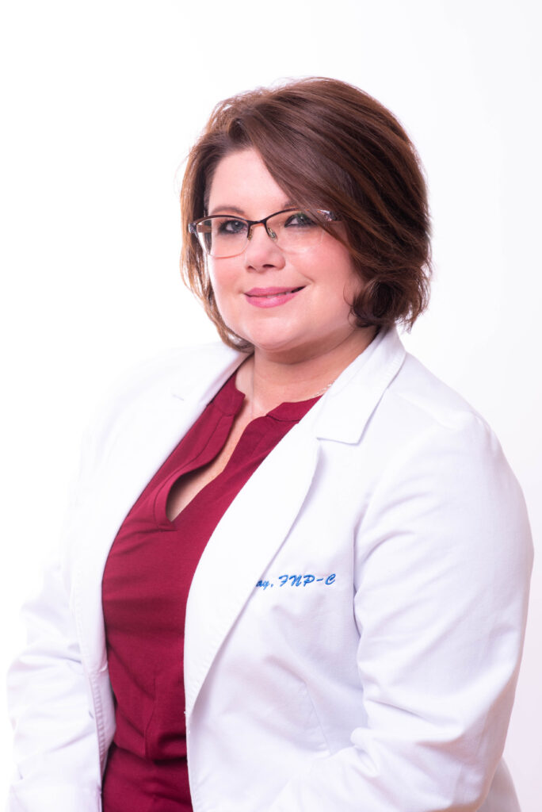
Your Provider
Lindsay M. Kreps, MSN, APRN, FNP-C
20 years experience in healthcare. Specializes in
Diabetic Care and Mental Health.
“I believe in treating the
person as a whole, not just
their illness.”

Slide 11
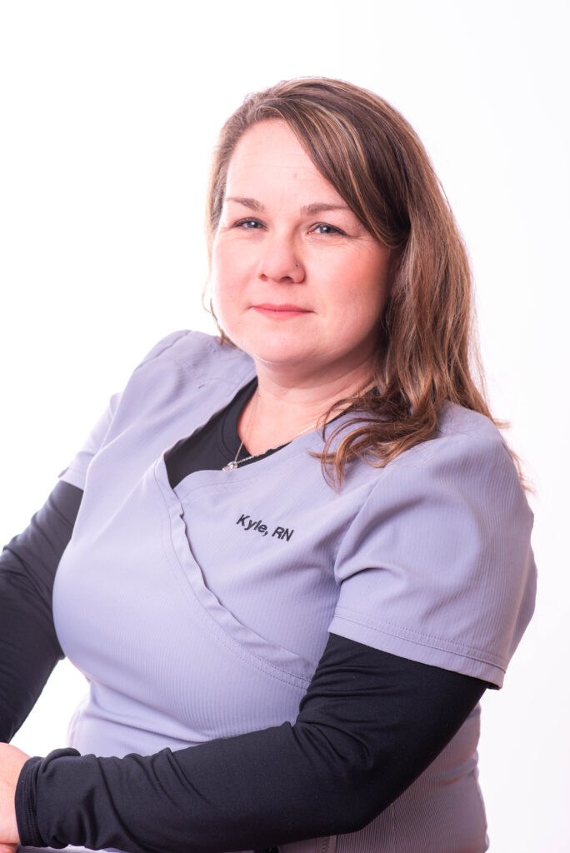
Your Nurse:
Kyle L. McDaniel, BSN, RN:
15 years experience in healthcare
Background in ER, Family Care, Geriatrics, Primary Care Management and Nurse Education.
“Quality healthcare focuses on the
patients needs, not demands of
the system.”

Slide 12
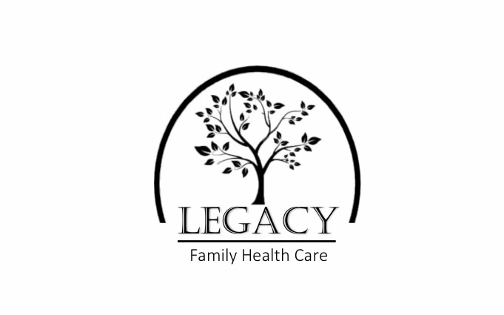
Your life is your legacy!
The Legacy Healthcare Team is committed to providing affordable quality healthcare with the goal of maximizing your quality of life!

Slide 13
References
https://www.legacyfamilyhealthcare.org/
https://dpcnation.org/
https://www.dpcfrontier.com/
https://directprimarycare.com/50-inspirational-quotes-for-docpreneurs-and-dpc-industry-influencers/

